Slide 1
Algorithm Definition Specification and Analysis
By Prasad VRK
02 Jan 2024

Slide 2
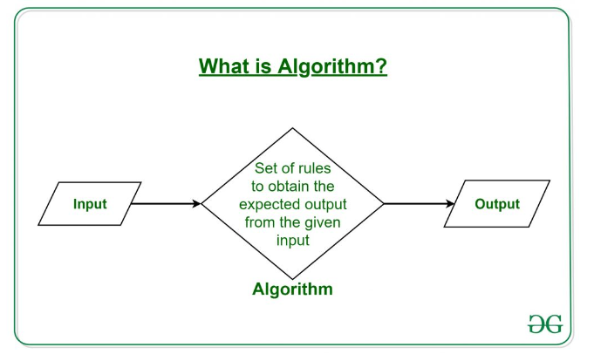
Definition of Algorithm
The word Algorithm means ” A set of finite rules or instructions to be followed in calculations or other problem-solving operations ” Or ” A procedure for solving a mathematical problem in a finite number of steps that frequently involves recursive operations”.

Slide 3
Use of the Algorithms
Computer Science: Algorithms form the basis of computer programming and are used to solve problems ranging from simple sorting and searching to complex tasks such as artificial intelligence and machine learning.
Mathematics: Algorithms are used to solve mathematical problems, such as finding the optimal solution to a system of linear equations or finding the shortest path in a graph.
Operations Research: Algorithms are used to optimize and make decisions in fields such as transportation, logistics, and resource allocation.
Artificial Intelligence: Algorithms are the foundation of artificial intelligence and machine learning, and are used to develop intelligent systems that can perform tasks such as image recognition, natural language processing, and decision-making.
Data Science: Algorithms are used to analyze, process, and extract insights from large amounts of data in fields such as marketing, finance, and healthcare.
These are just a few examples of the many applications of algorithms. The use of algorithms is continually expanding as new technologies and fields emerge, making it a vital component of modern society.

Slide 4
What is the need for algorithms?
Algorithms are necessary for solving complex problems efficiently and effectively.
They help to automate processes and make them more reliable, faster, and easier to perform.
Algorithms also enable computers to perform tasks that would be difficult or impossible for humans to do manually.
They are used in various fields such as mathematics, computer science, engineering, finance, and many others to optimize processes, analyze data, make predictions, and provide solutions to problems.

Slide 5
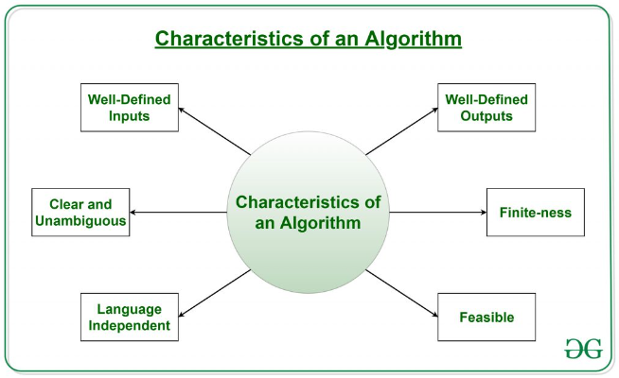
Characteristics of an Algorithm
Clear and Unambiguous:
The algorithm should be unambiguous. Each of its steps should be clear in all aspects and must lead to only one meaning.
Finite-ness:
The algorithm must be finite, i.e. it should terminate after a finite time.

Slide 6
Characteristics of an Algorithm conti…
Feasible:
The algorithm must be simple, generic, and practical, with the current Tech , but not future technology
Language Independent:
it must be just plain instructions that can be implemented in any language, yet same output
Input:
An algorithm has zero or more inputs. Must be well defined
Output:
An algorithm produces at least one output. Must be well defined
Definiteness:
All instructions in an algorithm must be unambiguous, precise, and easy to interpret.
Finiteness:
An algorithm must terminate after a finite number of steps in all test cases.
Infinite loops or recursive functions without base conditions do not possess finiteness.
Effectiveness:
An algorithm must be developed by using very basic, simple, and feasible operations so that one can trace it out by using just paper and pencil.

Slide 7
Properties of Algorithm
It should terminate after a finite time.
It should produce at least one output.
It should take zero or more input.
It should be deterministic means giving the same output for the same input case.
Every step in the algorithm must be effective i.e. every step should do some work

Slide 8
Types of Algorithms
1. Brute Force Algorithm:
More technically it is just like iterating every possibility available to solve that problem.
It is the simplest approach. A brute force algorithm is the first approach that comes to finding when we see a problem.
Example : If there is a lock of 4-digit PIN. The digits to be chosen from 0-9 then the brute force will be trying all possible combinations one by one like 0001, 0002, 0003, 0004, and so on until we get the right PIN. In the worst case, it will take 10,000 tries to find the right combination.
2. Recursive Algorithm:
In this case, a problem is broken into several sub-parts and called the same function again and again
Some common problem : Factorial of a Number, Fibonacci Series, Tower of Hanoi, DFS for Graph, etc.
3. Backtracking Algorithm:
In Backtracking Algorithm, the problem is solved in an incremental way
i.e. it is an algorithmic technique for solving problems recursively by trying to build a solution incrementally, one piece at a time, removing those solutions that fail to satisfy the constraints of the problem at any point of time.
Some common problems : Hamiltonian Cycle, M-Coloring Problem, N Queen Problem, Rat in Maze Problem, etc.

Slide 9
Types of Algorithms
4. Searching Algorithm:
Are used for searching elements or groups of elements from a particular data structure.
They can be of different types based on their approach or the data structure in which the element should be found.
Some common problems : Binary search or linear search is one example of a Searching algorithm.
5. Sorting Algorithm:
Sorting is arranging a group of data in a particular manner - data in an increasing or decreasing manner.
Some common problems : Bubble sort, insertion sort, merge sort, selection sort, and quick sort
Hashing Algorithm:
Similar to the searching algorithm. Contain an index with a key ID. In hashing, a key is assigned to specific data.
Some common problems can be solved through the Hashing Algorithm in password verification
7. Divide and Conquer Algorithm:
the idea is to solve the problem in two sections, the first section divides the problem into subproblems of the same type. The second section is to solve the smaller problem independently and then add the combined result to produce the final answer to the problem
3 steps - Breaks a problem into sub-problems, solves a single sub-problem, and merges the solutions to get the final solution.
Some common problem : Binary Search, Merge Sort, Quick Sort, Strassen’s Matrix Multiplication, etc.

Slide 10
Types of Algorithms Conti…
8. Greedy Algorithm:
In this type of algorithm, the solution is built part by part.
The solution for the next part is built based on the immediate benefit of the next part.
The one solution that gives the most benefit will be chosen as the solution for the next part.
It never considers the choices that had been taken previously.
Some common problems : Dijkstra Shortest Path Algorithm, Prim’s Algorithm, Kruskal’s Algorithm, Huffman Coding,
9. Dynamic Programming Algorithm:
Uses the concept of using the already found solution to avoid repetitive calculation of the same part of the problem.
It divides the problem into smaller overlapping subproblems and solves them.
Also known as the memoization technique because in this the idea is to store the previously calculated result to avoid calculating it again and again. In Dynamic Programming, divide the complex problem into smaller overlapping subproblems and store the result for future use. Some common problems : Knapsack Problem, Weighted Job Scheduling, Floyd Warshall Algorithm, etc.
10. Randomized Algorithm:
In the randomized algorithm, we use a random number.it helps to decide the expected outcome. The decision to choose the random number so it gives the immediate benefit Some common problems : Quicksort: In Quicksort we use the random number for selecting the pivot.

Slide 11
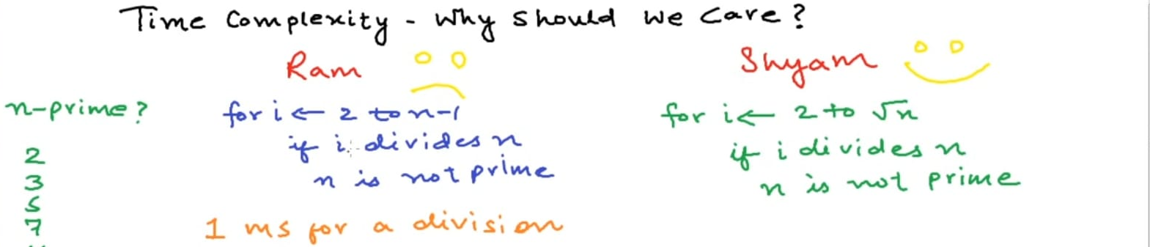
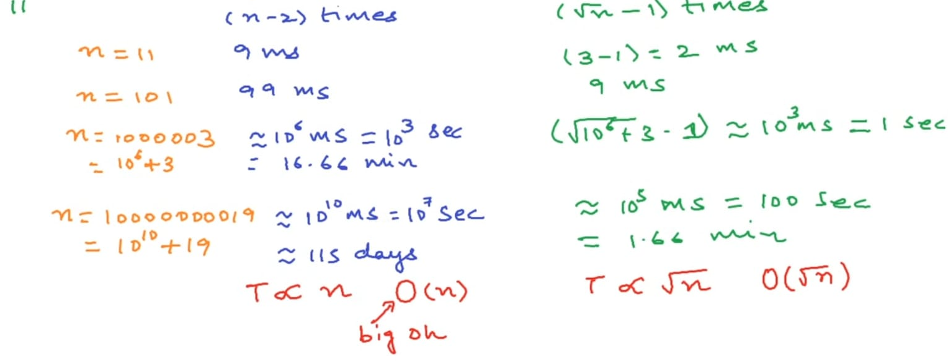
Time Complexity

Slide 12
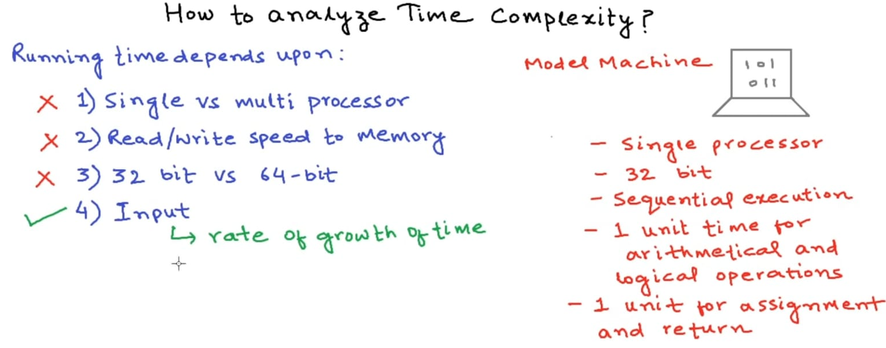
Asymptotic Notation..
Visualize a Model Machine
Interested in only Rate of Growth .. All other remain constant / same for different algorithms

Slide 13
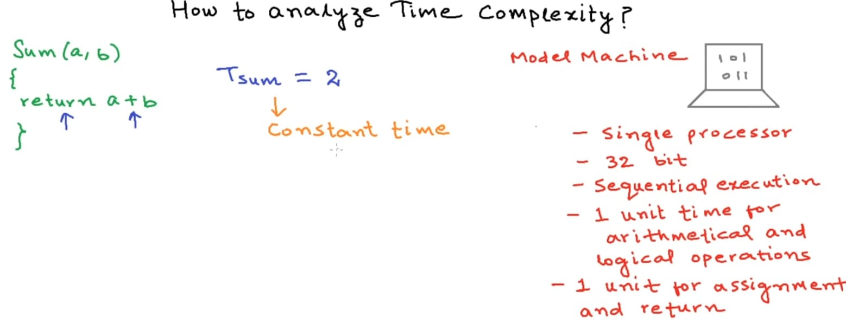
Asymptotic Notation.. Big Oh [O()]
Simple addition of two Numbers .. O(1)

Slide 14
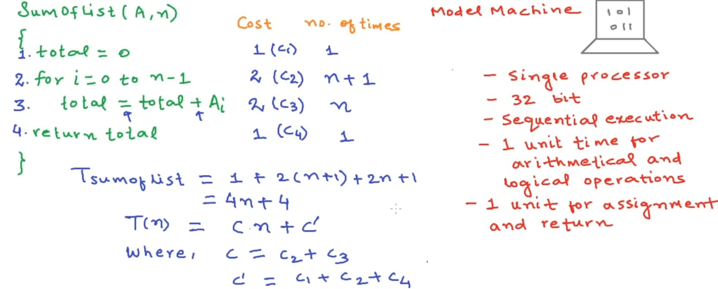
Asymptotic Notation.. Big Oh [O()]
Addition of all numbers of a Array.. O(n)
Derivation … in actual units as well as in generic notion as well
For loop runs for n+1 times, +1 time is for the testing of negative condition

Slide 15
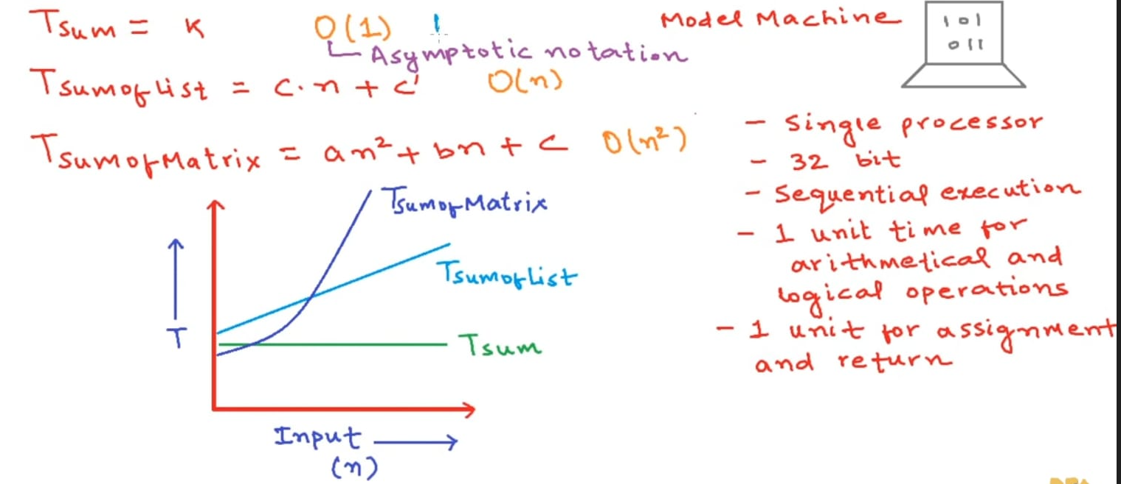
Asymptotic Notation.. Big Oh [O()]
Similarly for Sum of Matrix is square function
Graphically ..as input size grows … Quadratic function really takes off….

Slide 16
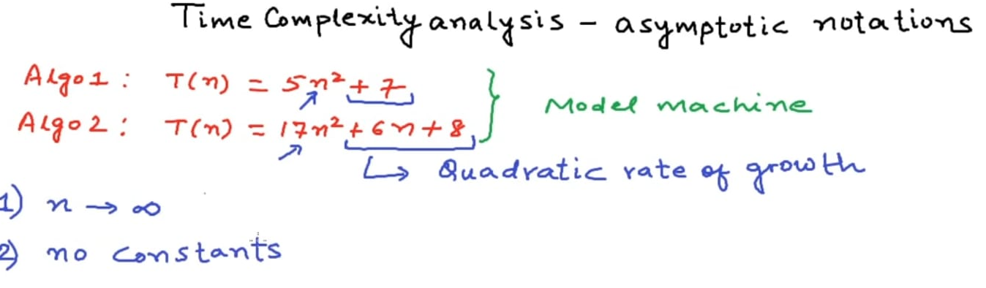
Asymptotic Notation.. Big Oh [O()]
Comparing two algorithms .. Each with a quadratic growth
As n approaches large number… non quadratic terms ,Constants become insignificant.. So also constants of Quadratic term..
Net result is ..we consider it as a set of Quadratic time complexity

Slide 17
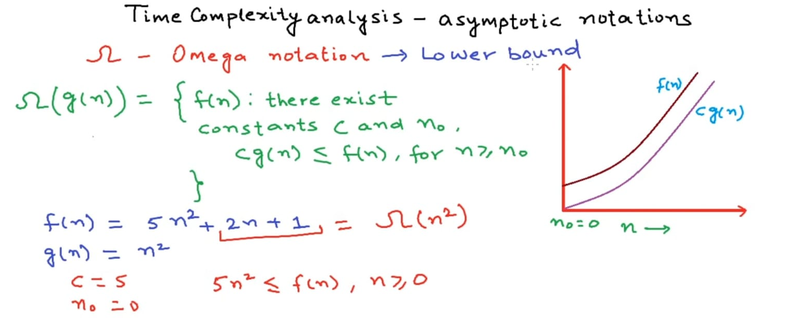
Asymptotic Notation.. Big Oh [O()]
5n^2 is always lesser than the all terns of f(n)
So it is a lower bound ….Best case …

Slide 18
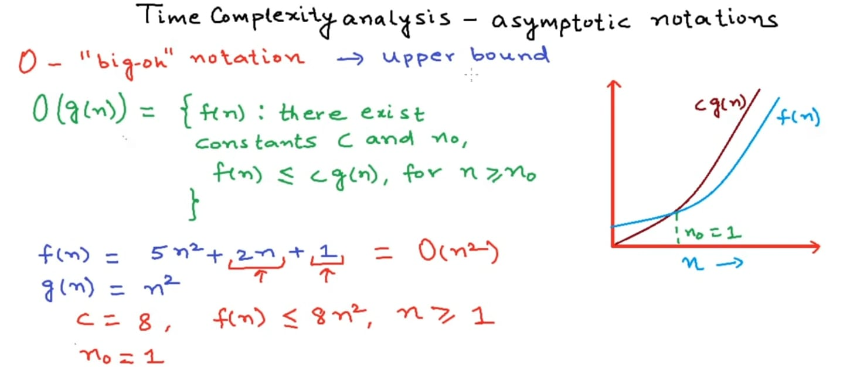
Asymptotic Notation.. Big Oh [O()]
Sum of 2n+1 will always be less than 5n^2 + 3 n^2 = 8 n^2
So it is a Upper bound ….worst case

Slide 19
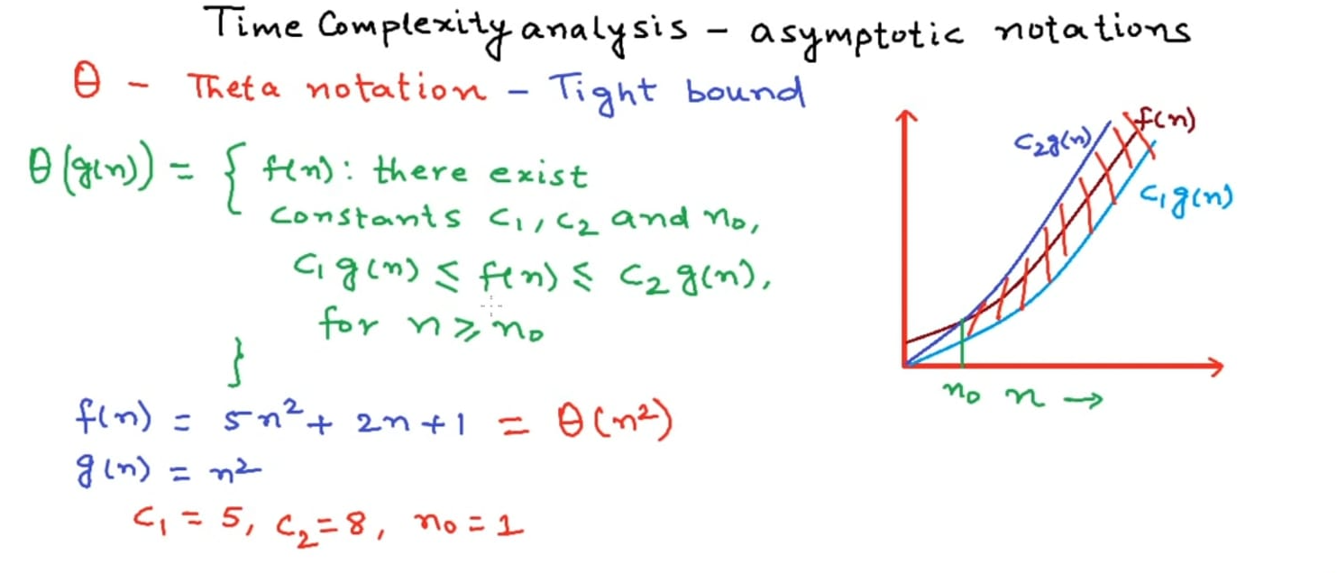
Asymptotic Notation.. Big Oh [O()]
Select both upper and lower limits and function is tight bound in between…
So it is a Average i.e. Tight bound ….

Slide 20
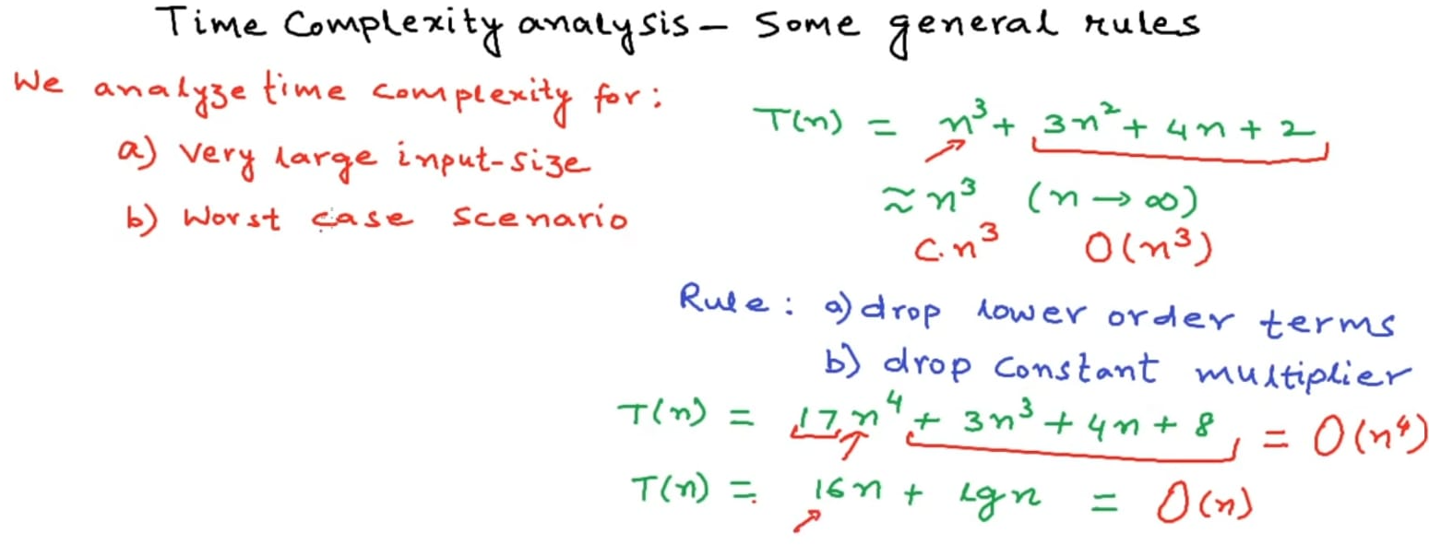
Time Complexity Analysis – Some General Rules
We need it for large input size and worst case
For some very large input size, lower order terms become insignificant , so also constant multiplier

Slide 21
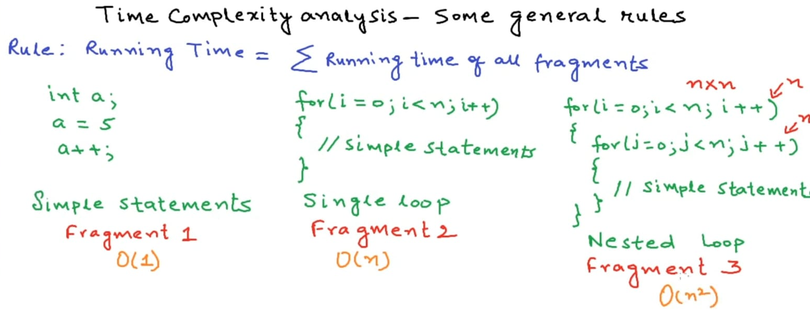
Time Complexity Analysis – Some General Rules conti..
Sum of all fragments rule →
For simple statements – it is one time
For a single loop – it is n times
For loop with in a loop – it is n^2

Slide 22
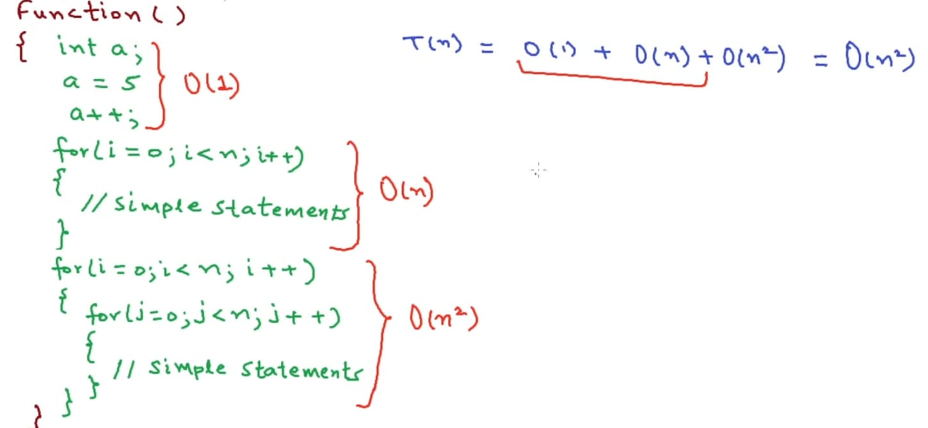
Time Complexity Analysis – Some General Rules conti..
Sum of all fragments rule →
Lower order terms will loose significance for very large size of input
So only second fragment weighs more

Slide 23
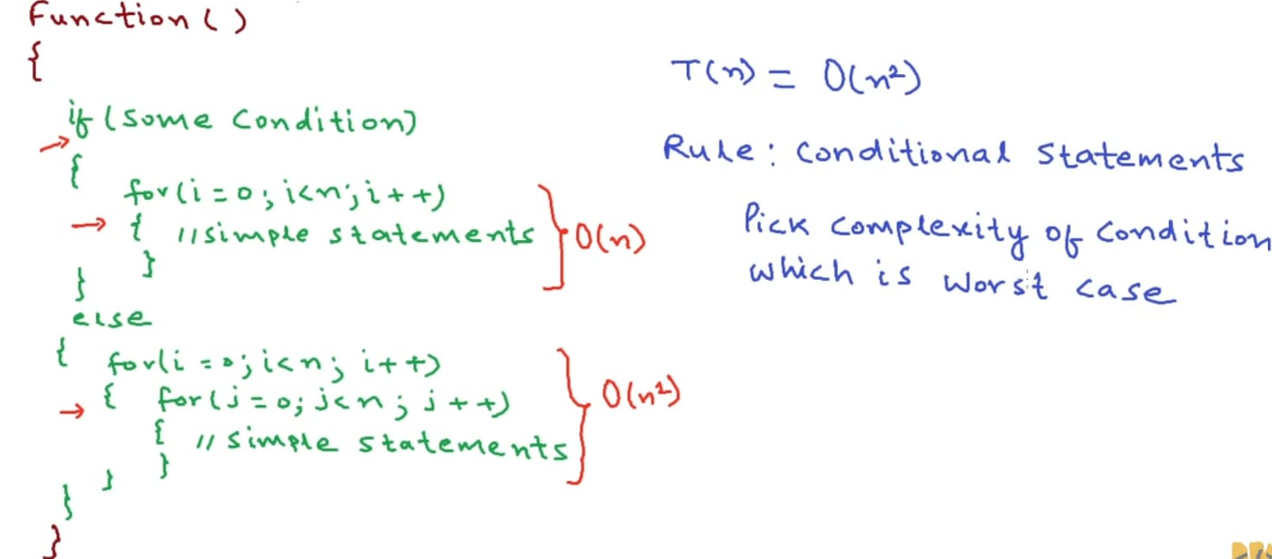
Time Complexity Analysis – Some General Rules conti..
Conditional Statements rule →
Pick up worst case fragment as a applicable fragment
So else part in this case

Slide 24
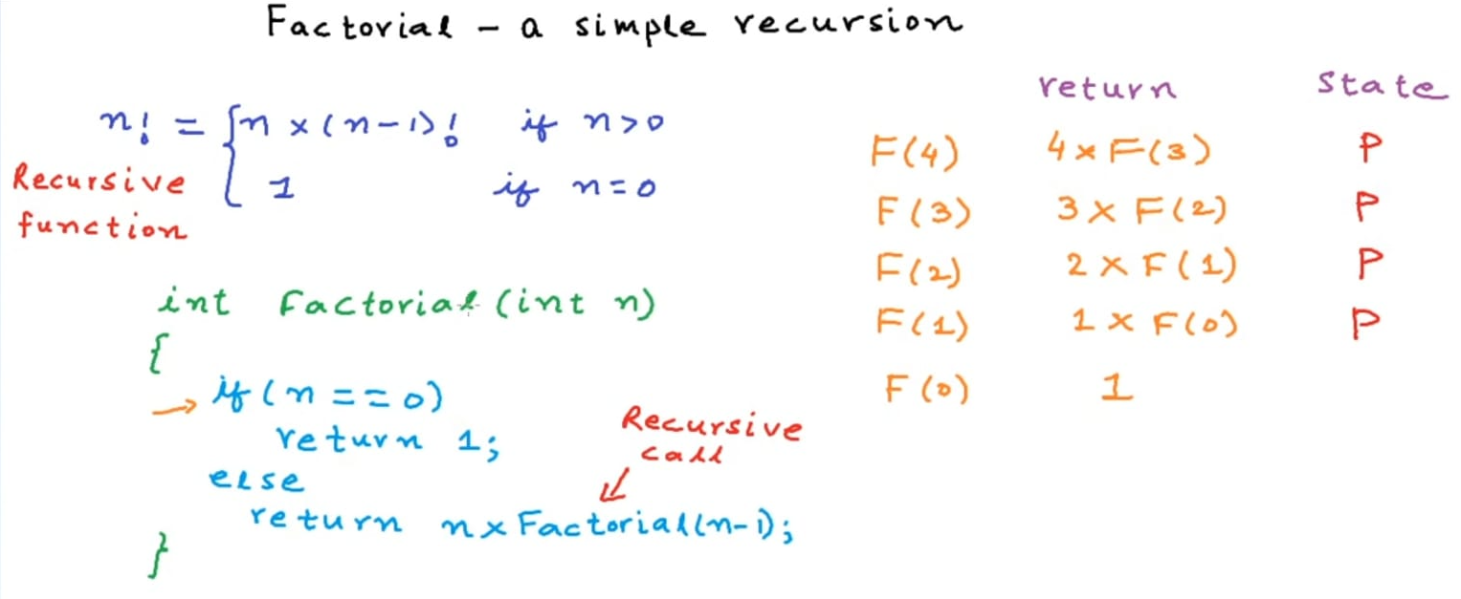
Recursion
Factorial – is a recursive function , calling itself with a reduced value as parameter
Have a base case which gives absolute value – wit out which code will go in infinite loop
Recursive function definition is easily mapped to a code
As the code runs, at each iteration, it saves the state and
Once it reaches the base condition, eventually , it starts unwinds to return the results

Slide 25
Recursion – Factorial - code
public class Factorial {
// Recursive Function to calculate the factorial of a number
static int factorial(int n) {
System.out.println("I am calculating Factorial("+n+")");
// Base case: If n is 0, the factorial is 1.
if (n == 0) {
System.out.println("I am Base case Factorial("+n+") and returning with 1");
return 1;
}
// Recursive case: Calculate the factorial by multiplying n with the factorial of (n - 1).
int F = n * factorial(n - 1);
System.out.println("Done! Factorial("+n+") and its value F = "+F);
return F;
}
public static void main(String[] args) {
int n = 4;
// Calculate and print the factorial of n.
int result = factorial(n);
System.out.println("Factorial of " + n + " is: " + result);
}
}

Slide 26
Recursion – Factorial code - Run
I am calculating Factorial(4)
I am calculating Factorial(3)
I am calculating Factorial(2)
I am calculating Factorial(1)
I am calculating Factorial(0)
I am Base case Factorial(0) and returning with 1
Done! Factorial(1) and its value F = 1
Done! Factorial(2) and its value F = 2
Done! Factorial(3) and its value F = 6
Done! Factorial(4) and its value F = 24
Factorial of 4 is: 24
Clearly demonstrating the Stack build up and unwinding…

Slide 27
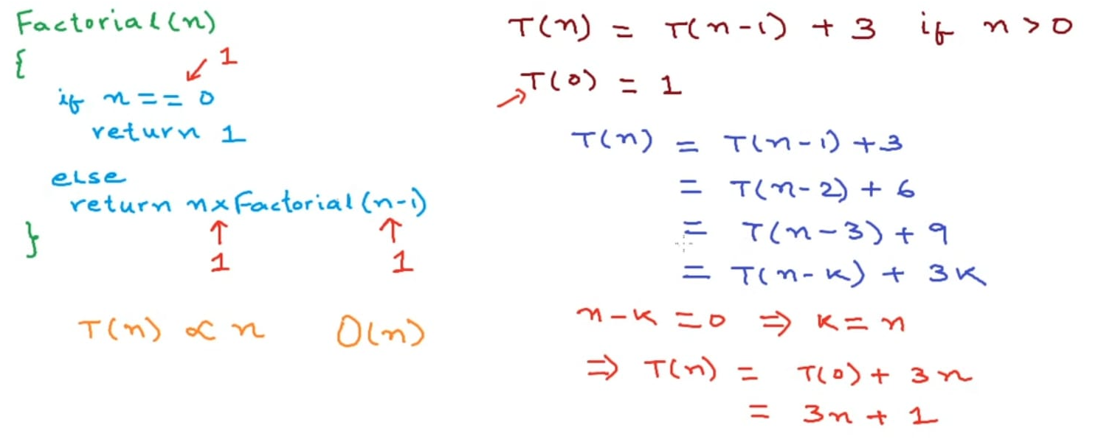
Recursion – Time Complexity analysis [ O () ]
Factorial – is a recursive function , calling itself with a reduced value as parameter
Assuming each operation takes a 1 unit of time
Calculating total time, by successively calling its next number …
And generalizing it with T(n-k)… and calculatingfor base condition by equating n-k = 0
It is O (n)

Slide 28
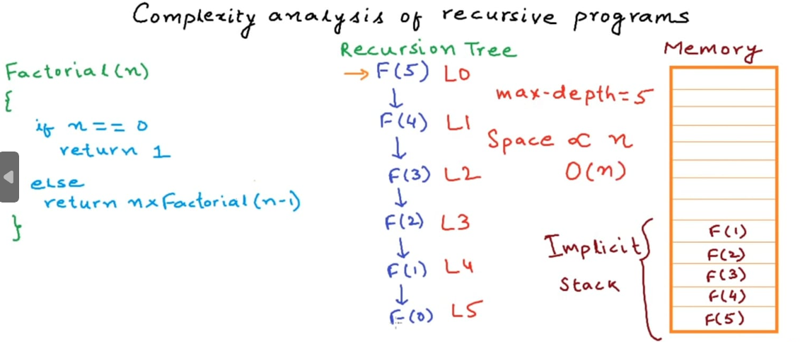
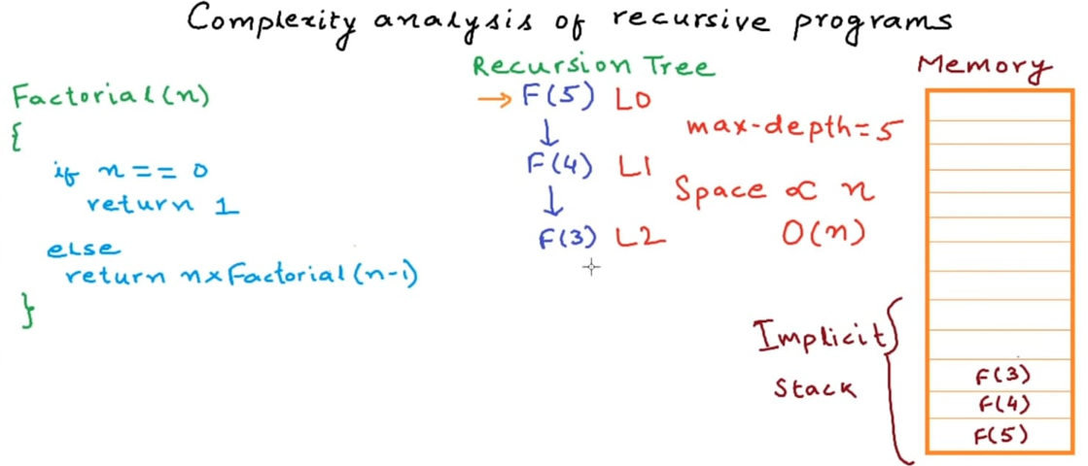
Recursion – Space Complexity analysis [ O () ]
Factorial – is a recursive function , calling itself with a reduced value as parameter
Implicit memory stack gets created as Factorial recursive calls its successively lower number Factorial
Max depth of Stack is n
As the stack gets unwind, the height of Stack gets reduced one step at a time and eventually clears stack
So Space complexity is O (n)
Note : Recursive calls are same as calling any other function calls .. except that in Recursive calls , the height of Stack si same as input parameter of n , which can be quite large in value

Slide 29
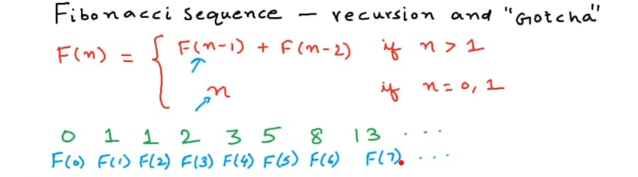
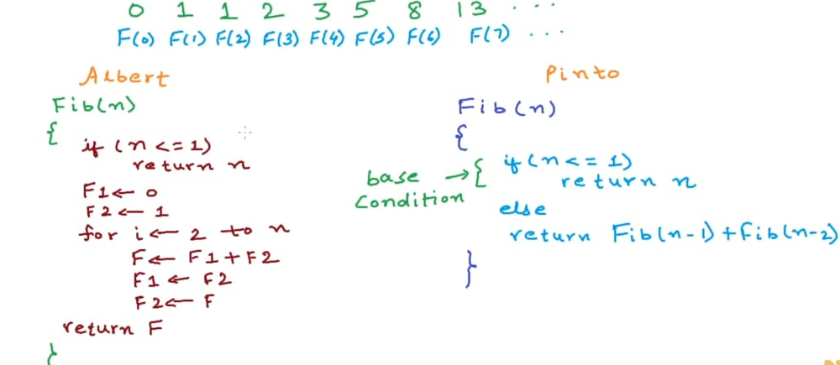
Fibonacci Sequence – Recursion and Gotcha
Fibonacci Sequence - is a sequence where a given number is a sum of its two previous numbers
Can be written as
Iterative → Albert
Recursive → Pinto

Slide 30
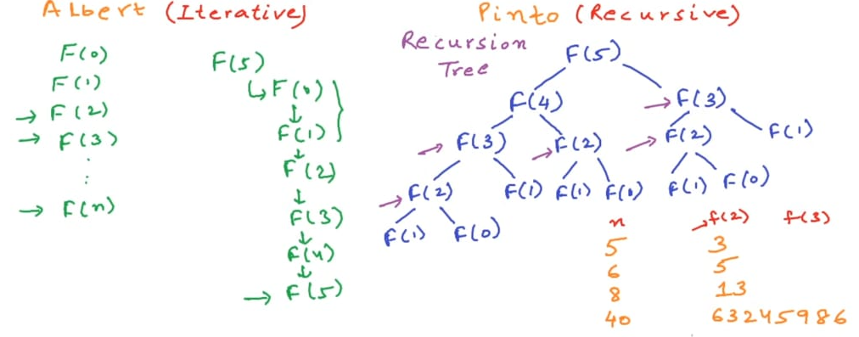
Fibonacci Sequence – Recursion and Gotcha
Fibonacci Sequence - Iterative → Albert
It is a simple loop – starting from base condition to its required length
Complexity is O(n)
It returns quickly even for a modest sequence length of 40
Fibonacci Sequence - Recursive → Pinto
It builds a Recursive Tree
At each stage it attempts to calculate its predecessor number
As a result especially lower number Fibonacci values are repeatedly calculated
This repetition is so large, it runs visibly slower
So much so for a modest number of n = 40,F(2) is invoked 63245986 times
Solution is memoization

Slide 31
Fibonacci Sequence – Recursion and Gotcha
Fibonacci Sequence - Iterative → Albert
It is a simple loop – starting from base condition to its required length
Complexity is O(n)
It returns quickly even for a modest sequence length of 40
Fibonacci Sequence - Recursive → Pinto
It builds a Recursive Tree
At each stage it attempts to calculate its predecessor number
As a result especially lower number Fibonacci values are repeatedly calculated
This repetition is so large, it runs visibly slower
So much so for a modest number of n = 40,F(2) is invoked 63245986 times
Solution is memoization

Slide 32
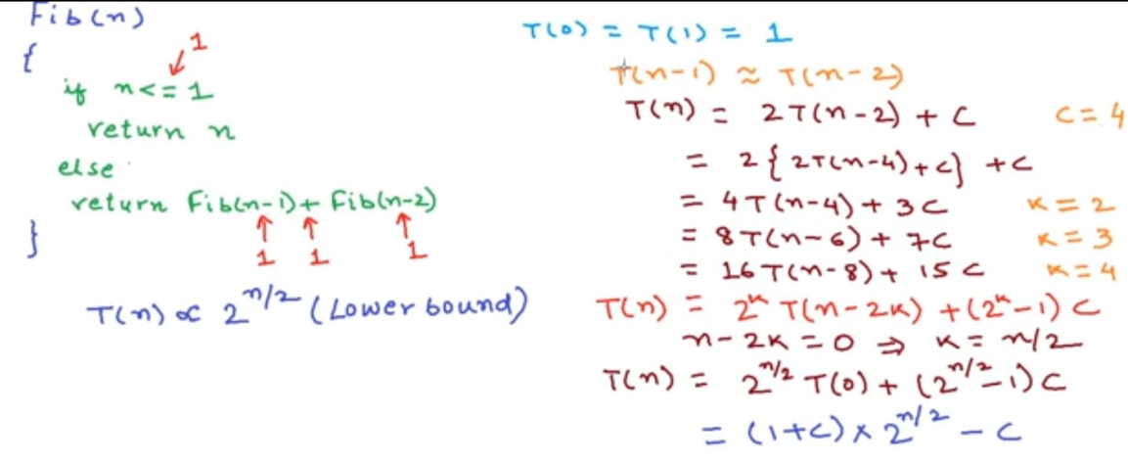
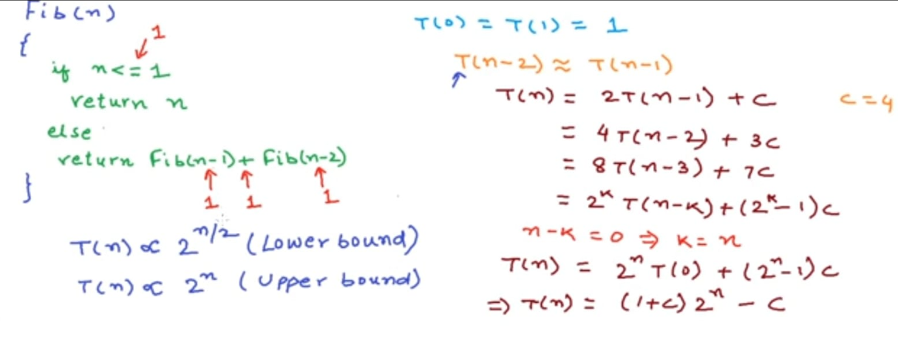
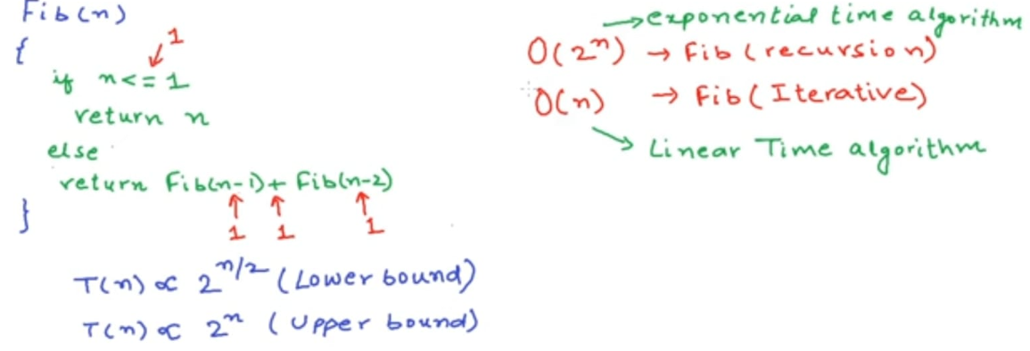
Fibonacci Sequence – Time Complexity Analysis
Fibonacci Sequence – Recursive Time complexity – Derive both Lower bound and upper bound
Key assumption is T(n-1) approx. equal to T(n-2) . This is the case for very large values of n
Lower bound : Consider T(n-1) as equivalent to T(n-2) [ i.e. treating a LESS valuable than it is ]
Upper bound : Consider T(n-2) as equivalent to T(n-1) [ i.e. treating a MORE valuable than it is ]
Fibonacci sequence – Iterative Time complexity is O(n)

Slide 33
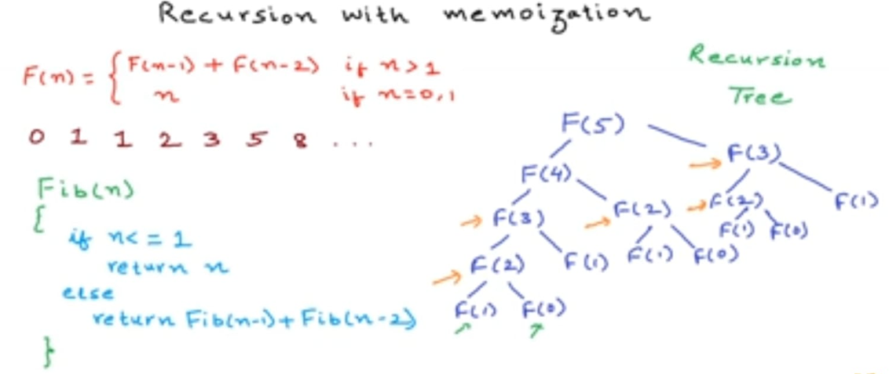
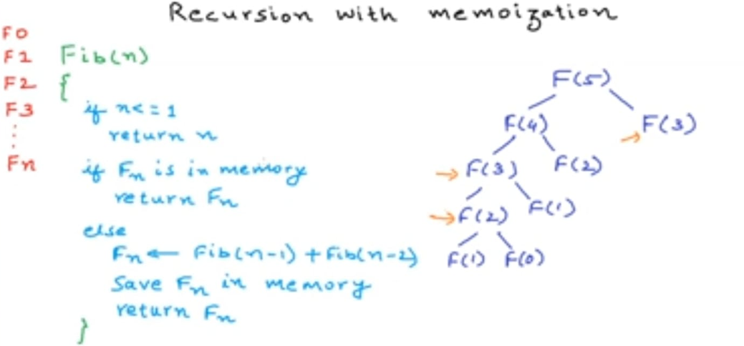
Fibonacci Sequence – Memoization - Time Complexity Analysis
Fibonacci Sequence – Recursive with Memoization
Recursive tree expands , repeatedly calling previously calculated functions
With memoization – previously calculated function values are saved and reused
This significantly truncates the Recursive tree growth , especially for already calculated values

Slide 34
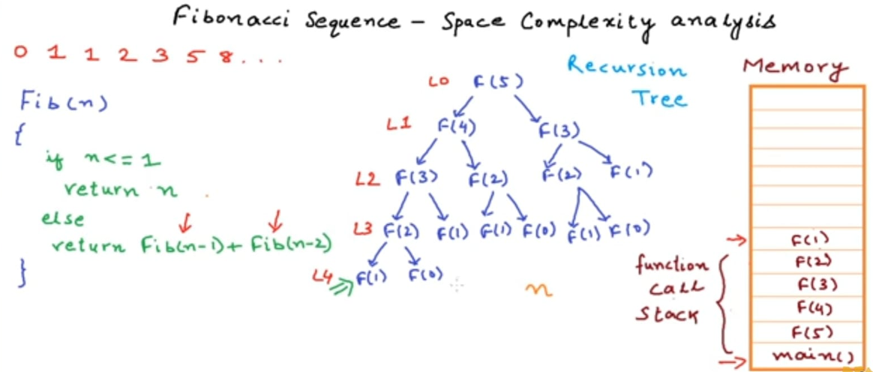
Fibonacci Sequence – Memoization – Space Complexity Analysis
Fibonacci Sequence – Recursive with Memoization
Recursive tree expands , repeatedly calling previously calculated functions
With memoization – previously calculated function values are saved and reused
However the Function call stack height will remain same as n [ L0 to L4 ]

Slide 35
How AI large language models work
ChatGPT – LLM – Predict Next word . But how ?
Based on Neural Networks that was trained using billions of words of ordinary language
Agenda
Explaining word vectors - the surprising way language models represent and reason about language.
Dive deep into the transformer, the basic building block for systems like ChatGPT.
Explain how these models are trained
and explore why good performance requires such phenomenally large quantities of data

Slide 36
Word vectors
Humans represent English words with a sequence of letters, like C-A-T for "cat."
Language models use a long list of numbers called a "word vector.“
[0.0074, 0.0030, -0.0105, 0.0742, 0.0765, -0.0011, 0.0265, 0.0106, 0.0191, 0.0038, -0.0468, -0.0212, 0.0091, 0.0030, -0.0563, -0.0396, -0.0998, -0.0796, …, 0.0002]
The full vector is 300 numbers long
Why its so crazy ? – As an Analogy
Washington, DC, is located at 38.9 degrees north and 77 degrees west.
We can represent this using a vector notation:
Washington, DC, is at [38.9, 77]
New York is at [40.7, 74]
London is at [51.5, 0.1]
Paris is at [48.9, -2.4]
This is useful for reasoning about spatial relationships.
You can tell New York is close to Washington, DC, because 38.9 is close to 40.7 and 77 is close to 74.
By the same token, Paris is close to London. But Paris is far from Washington, DC.
Language models take a similar approach:
Each word vector represents a point in an imaginary “word space,” and words with more similar meanings are placed closer together
technically, LLMs operate on fragments of words called tokens
Words are too complex to represent in only two dimensions, so language models use vector spaces with hundreds or even thousands of dimensions

Slide 37
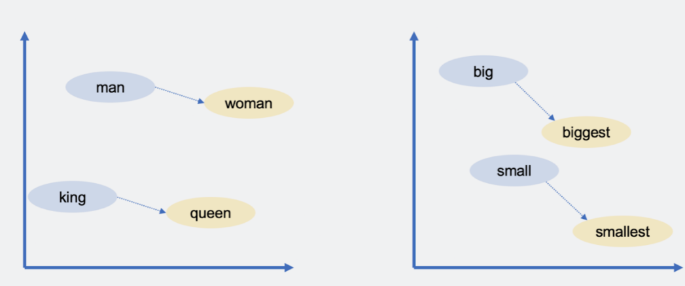
Word vectors
word vectors for decades, but the concept really took off when Google announced its word2vec project in 2013.
Google analyzed millions of documents harvested from Google News to figure out which words tend to appear in similar sentences.
Over time, a neural network trained to predict which words co-occur with other words learned to place similar words (like dog and cat) close together in vector space.
Google’s word vectors had another intriguing property:
You could “reason” about words using vector arithmetic.
For example, Google researchers took the vector for "biggest," subtracted "big," and added "small." The word closest to the resulting vector was "smallest."

Slide 38
Word vectors
word vectors for decades, but the concept really took off when Google announced its word2vec project in 2013.
Google analyzed millions of documents of Google News to figure out which words tend to appear in similar sentences.
Over time, a neural network trained to predict which words co-occur with other words learned to place similar words (like dog and cat) close together in vector space.
Google’s word vectors had another intriguing property:
You could “reason” about words using vector arithmetic.
For example, Google researchers took the vector for "biggest," subtracted "big," and added "small." The word closest to the resulting vector was "smallest.“
You can use vector arithmetic to draw analogies! In this case, big is to biggest as small is to smallest.
Google’s word vectors captured a lot of other relationships:
Swiss is to Switzerland as Cambodian is to Cambodia (nationalities)
Paris is to France as Berlin is to Germany (capitals)
Unethical is to ethical as possibly is to impossibly (opposites)
Mouse is to mice as dollar is to dollars (plurals)
Man is to woman as king is to queen (gender roles)
Nevertheless, word vectors are a useful building block for language models
because they encode subtle but important information about the relationships between words.
If a language model learns something about a cat (for example, it sometimes goes to the vet),
the same thing is likely to be true of a kitten or a dog.
If a model learns something about the relationship between Paris and France (for example, they share a language),
there’s a good chance that the same will be true for Berlin and Germany and for Rome and Italy.

Slide 39
Word meaning depends on context
A simple word vector scheme like this doesn’t capture an important fact about natural language: Words often have multiple meanings.
For example, the word "bank" can refer to a financial institution or to the land next to a river.
consider the following sentences:
John picks up a magazine.
Susan works for a magazine.
The meanings of magazine in these sentences are related but subtly different.
John picks up a physical magazine,
Susan works for an organization that publishes physical magazines.
homonyms : When a word has two unrelated meanings, as with bank
polysemy : When a word has two closely related meanings, as with magazine.
LLMs like ChatGPT are able to represent the same word with different vectors depending on the context in which that word appears.
There’s a vector for bank (financial institution) and a different vector for bank (of a river).
There’s a vector for magazine (physical publication) and another for magazine (organization).
As you might expect, LLMs use more similar vectors for polysemous meanings than homonymous ones.
But we’re belaboring these vector representations because it’s fundamental to understanding how language models work.

Slide 40
Word meaning depends on context
But we’re belaboring these vector representations because it’s fundamental to understanding how language models work.
Traditional software is designed to operate on data that’s unambiguous.
If you ask a computer to compute “2 + 3,” there’s no ambiguity about what 2, +, or 3 mean.
But natural language is full of ambiguities that go beyond homonyms and polysemy:
In “the customer asked the mechanic to fix his car,” does "his" refer to the customer or the mechanic?
There are no simple or deterministic rules for doing this. Rather, it requires understanding facts about the world
Word vectors provide a flexible way for language models to represent each word’s precise meaning in the context of a particular passage

Slide 41
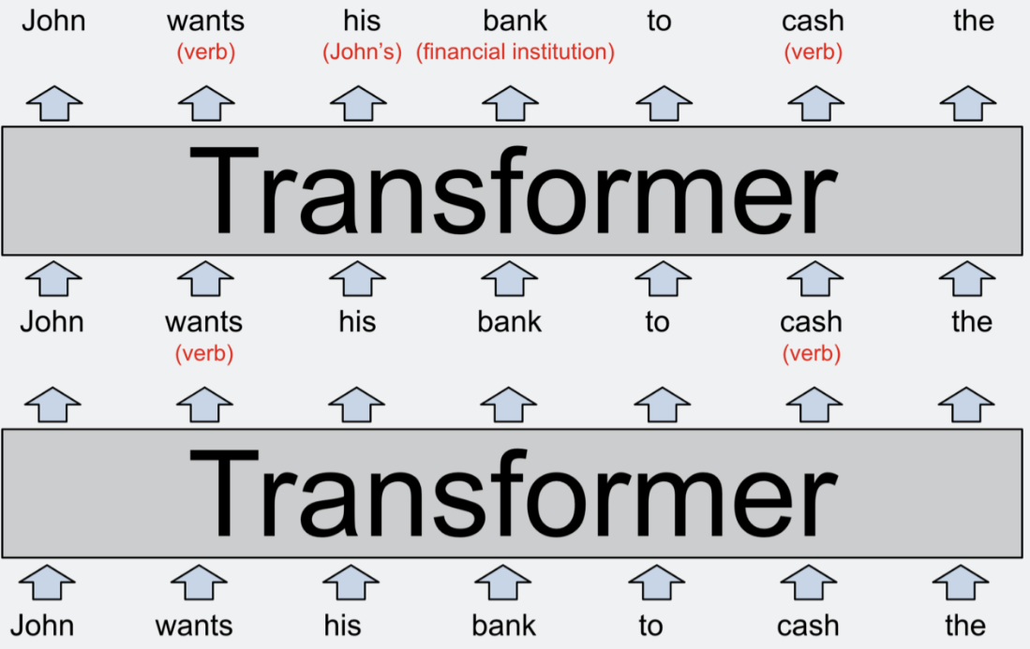
Transforming word vectors into word predictions
The model’s input, shown at the bottom of the diagram, is the partial sentence “John wants his bank to cash the.”
These words, represented as word2vec-style vectors, are fed into the first transformer.
The transformer figures out that wants and cash are both verbs (both words can also be nouns). ( red text)
Model would store it by modifying the word vectors in ways that are difficult for humans to interpret.
These new vectors, known as a hidden state, are passed to the next transformer in the stack.
The second transformer adds two other bits of context: It clarifies that "bank" refers to a financial institution rather than a river bank, and that "his" is a pronoun that refers to John. The second transformer produce
GPT-3, a 2020 predecessor to the language models that power ChatGPT, is organized into dozens of layers.
Each layer takes a sequence of vectors as inputs—one vector for each word in the input text—and adds information to help clarify the meaning of that word and better predict which word might come next.
Each layer of an LLM is a transformer, a neural network architecture that was first introduced by Google in a landmark 2017 paper.

Slide 42
Transforming word vectors into word predictions
For example, the most powerful version of GPT-3 uses word vectors with 12,288 dimensions
that is, each word is represented by a list of 12,288 numbers.
That’s 20 times larger than Google’s 2013 word2vec scheme.
You can think of all those extra dimensions as a kind of “scratch space” that GPT-3 can use to write notes to itself about the context of each word.
Notes made by earlier layers can be read and modified by later layers, allowing the model to gradually sharpen its understanding of the passage as a whole.
So suppose we changed our diagram above to depict a 96-layer language model interpreting a 1,000-word story. The 60th layer might include a vector for "John" with a parenthetical comment like “(main character, male, married to Cheryl, cousin of Donald, from Minnesota, currently in Boise, trying to find his missing wallet).”
Again, all of these facts (and probably a lot more) would somehow be encoded as a list of 12,288 numbers corresponding to the word John.
Or perhaps some of this information might be encoded in the 12,288-dimensional vectors for Cheryl, Donald, Boise, wallet, or other words in the story.
The goal is for the 96th and final layer of the network to output a hidden state for the final word that includes all of the information necessary to predict the next word.

Slide 43
what happens inside each transformer
The transformer has a two-step process for updating the hidden state for each word of the input passage:
Attention step, words “look around” for other words that have relevant context &share information with one another.
feed-forward step, each word “thinks about” information gathered in previous attention steps and tries to predict the next word.
Note that transformers treat words, rather than entire sentences or passages, as the basic unit of analysis
This approach enables LLMs - To over come two challenges earlier language models struggled
to take full advantage of the massive parallel processing power of modern GPU chips.
And it also helps LLMs to scale to passages with thousands of words.
Attention mechanism
a matchmaking service for words.
Each word makes a checklist (called a query vector) describing the characteristics of words it is looking for.
Each word also makes a checklist (called a key vector) describing its own characteristics.
The network compares each key vector to each query vector (by computing a dot product) to find the words that are the best match.
Once it finds a match, it transfers information from the word that produced the key vector to the word that produced the query vector
Each attention layer has several “attention heads,” which means that this information-swapping process happens several times (in parallel) at each layer. Each attention head focuses on a different task:
One attention head might match pronouns with nouns.
Another attention head might work on resolving the meaning of homonyms like "bank."
A third attention head might link together two-word phrases like “Joe Biden.”

Slide 44
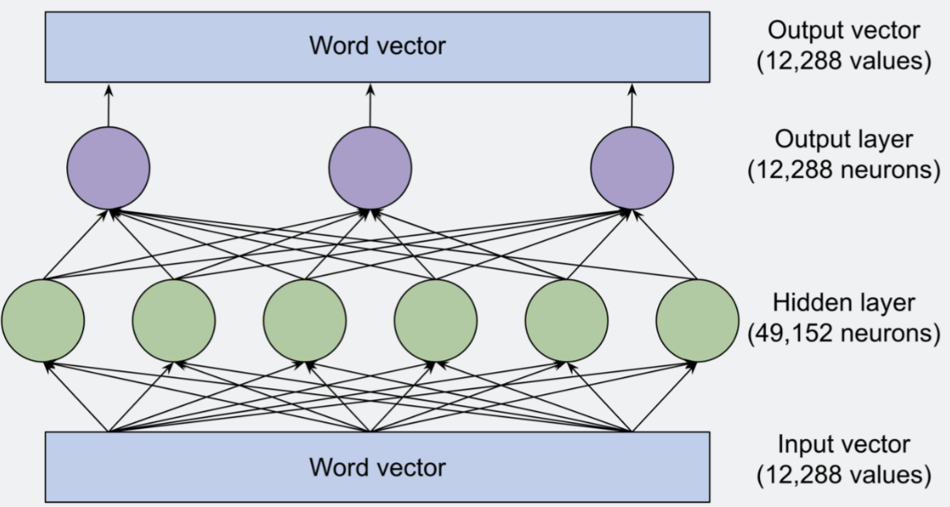
what happens inside each transformer
Attention heads frequently operate in sequence,
with the results of an attention operation in one layer becoming an input for an attention head in a subsequent layer.
Indeed, each of the tasks we just listed above could easily require several attention heads rather than just one.
The largest version of GPT-3 has 96 layers with 96 attention heads each,
so GPT-3 performs 9,216 attention operations each time it predicts a new word
The feed-forward step
“thinks about” each word vector and tries to predict the next word
No information is exchanged between words at this stage: the feed-forward layer analyzes each word in isolation
the feed-forward layer does have access to any information that was previously copied by an attention head
The green and purple circles are neurons, mathematical functions that compute a weighted sum of their inputs.
What makes the feed-forward layer powerful is its huge number of connections.
We’ve drawn this network with three neurons in the output layer and six neurons in the hidden layer,
but the feed-forward layers of GPT-3 are much larger:
12,288 neurons in the output layer (corresponding to the model’s 12,288-dimensional word vectors) and 49,152 neurons in the hidden layer.

Slide 45
what happens inside each transformer
So in the largest version of GPT-3,
there are 49,152 neurons in the hidden layer, with 12,288 inputs (and hence 12,288 weight parameters) for each neuron.
And there are 12,288 output neurons with 49,152 input values (and hence 49,152 weight parameters) for each neuron.
This means that each feed-forward layer has 49,152 * 12,288 + 12,288 * 49,152 = 1.2 billion weight parameters.
And there are 96 feed-forward layers,
for a total of 1.2 billion * 96 = 116 billion parameters!
This accounts for almost two-thirds of GPT-3’s overall total of 175 billion parameters.
Research paper - Here are some of the patterns that were matched by neurons in a 16-layer version of GPT-2:
A neuron in layer 1 matched sequences of words ending with “substitutes.”
A neuron in layer 6 matched sequences related to the military and ending with “base” or “bases.”
A neuron in layer 13 matched sequences ending with a time range such as “between 3 pm and 7” or “from 7:00 pm Friday until.”
A neuron in layer 16 matched sequences related to television shows such as “the original NBC daytime version, archived” or “time shifting viewing added 57 percent to the episode’s.”
As you can see, patterns got more abstract in the later layers.
The early layers tended to match specific words,
whereas later layers matched phrases that fell into broader semantic categories such as television shows or time intervals.

Slide 46
what happens inside each transformer
This is interesting because, as mentioned previously, the feed-forward layer examines only one word at a time.
So when it classifies the sequence “the original NBC daytime version, archived” as related to television, it only has access to the vector for archived, not words like NBC or daytime.
Presumably, the feed-forward layer can tell that "archived" is part of a television-related sequence because attention heads previously moved contextual information into the archived vector.

Slide 47
Feed-forward networks reason with vector math
Google’s word2vec research showing it was possible to use vector arithmetic to reason by analogy. For example, Berlin - Germany + France = Paris
The following prompt: “Q: What is the capital of France? A: Paris Q: What is the capital of Poland? A:”
version of GPT-2 with 24 layers.
After each layer, the Brown scientists probed the model to observe its best guess at the next token.
For the first 15 layers, the top guess was a seemingly random word.
Between the 16th and 19th layer, the model started predicting that the next word would be Poland—not correct, but getting warmer.
Then at the 20th layer, the top guess changed to Warsaw—the correct answer—and stayed that way in the last four layers.
The Brown researchers found that the 20th feed-forward layer converted Poland to Warsaw by adding a vector that maps country vectors to their corresponding capitals.
Adding the same vector to China produced Beijing.
Feed-forward layers in the same model used vector arithmetic to transform
lower-case words into upper-case words and
present-tense words into their past-tense equivalents.

Slide 48
The attention and feed-forward layers have different jobs
Google’s word2vec research showing it was possible to use vector arithmetic to reason by analogy. For example, Berlin - Germany + France = Paris
The following prompt: “Q: What is the capital of France? A: Paris Q: What is the capital of Poland? A:”
version of GPT-2 with 24 layers.
After each layer, the Brown scientists probed the model to observe its best guess at the next token.
For the first 15 layers, the top guess was a seemingly random word.
Between the 16th and 19th layer, the model started predicting that the next word would be Poland—not correct, but getting warmer.
Then at the 20th layer, the top guess changed to Warsaw—the correct answer—and stayed that way in last four layers.
The Brown researchers found that the 20th feed-forward layer converted Poland to Warsaw by adding a vector that maps country vectors to their corresponding capitals.
Adding the same vector to China produced Beijing.
Feed-forward layers in the same model used vector arithmetic to transform
lower-case words into upper-case words and
present-tense words into their past-tense equivalents.
When the Brown researchers disabled the feed-forward layer that converted Poland to Warsaw,
the model no longer predicted Warsaw as the next word.
But interestingly, if they then added the sentence “The capital of Poland is Warsaw” to the beginning of the prompt, then GPT-2 could answer the question again.
This is probably because GPT-2 used attention heads to copy the name Warsaw from earlier in the prompt.

Slide 49
The attention and feed-forward layers have different jobs
This division of labor holds more generally:
Attention heads retrieve information from earlier words in a prompt,
feed-forward layers enable language models to “remember” information that’s not in the prompt.
Indeed, one way to think about the
feed-forward layers is as a database of information the model has learned from its training data.
The earlier feed-forward layers are more likely to encode simple facts related to specific words,
such as “Trump often comes after Donald.”
Later layers encode more complex relationships
like “add this vector to convert a country to its capital.”

Slide 50
How language models are trained
A key innovation of LLMs is that they don’t need explicitly labeled data manually.
Instead, they learn by trying to predict the next word in ordinary passages of text.
Almost any written material—from Wikipedia pages to news articles to computer code— is suitable for training models.
But as the model sees many more examples—hundreds of billions of words—those weights are gradually adjusted to make better and better predictions
An analogy.
Suppose you’re going to take a shower, and you want the temperature to be just right: not too hot and not too cold.
You’ve never used this faucet before,
so you point the knob in a random direction and feel the temperature of the water.
If it’s too hot, you turn it one way;
if it’s too cold, you turn it the other way.
The closer you get to the right temperature, the smaller the adjustments you make.

Slide 51
How language models are trained
Now let’s make a couple of changes to the analogy.
First,
imagine that there are 50,257 faucets instead of just one.
Each faucet corresponds to a different word like "the," "cat," or "bank."
Your goal is to have water only come out of the faucet corresponding to the next word in a sequence.
Second,
there’s a maze of interconnected pipes behind the faucets,
and these pipes have a bunch of valves on them as well.
So if water comes out of the wrong faucet, you don’t just adjust the knob at the faucet.
You dispatch an army of intelligent squirrels to trace each pipe backward & adjust each valve they find along the way.
This gets complicated because the same pipe often feeds into multiple faucets.
So it takes careful thought to figure out which valves to tighten and which ones to loosen, and by how much.
Obviously, this example quickly gets silly if you take it too literally.
It wouldn’t be realistic or useful to build a network of pipes with 175 billion valves.
But thanks to Moore’s Law, computers can and do operate at this kind of scale.
All the parts of LLMs we’ve discussed in this article so far
the neurons in the feed-forward layers and the attention heads that move contextual information between words
are implemented as a chain of simple mathematical functions (mostly matrix multiplications)
whose behavior is determined by adjustable weight parameters.
Just as the squirrels in my story loosen and tighten the valves to control the flow of water, so the training algorithm increases or decreases the language model’s weight parameters to control how information flows through the neural network.

Slide 52
How language models are trained
The training process happens in two steps.
First there’s a “forward pass,”
where the water is turned on and you check if it comes out the right faucet.
Then the water is turned off
Second there’s a “backward pass”
where the squirrels race along each pipe tightening and loosening valves.
In digital neural networks, the role of the squirrels is played by an algorithm called backpropagation,
which “walks backward” through the network, using calculus to estimate how much to change each weight parameter.
Completing this process
doing a forward pass with one example and then a backward pass to improve the network’s performance on that example
requires hundreds of billions of mathematical operations.
And training a model as big as GPT-3 requires repeating the process across many, many examples.
OpenAI estimates that it took more than 300 billion trillion floating point calculations to train GPT-3
that’s months of work for dozens of high-end computer chips.

Slide 53
The surprising performance of GPT-3
The training process happens in two steps.

